Slide 1
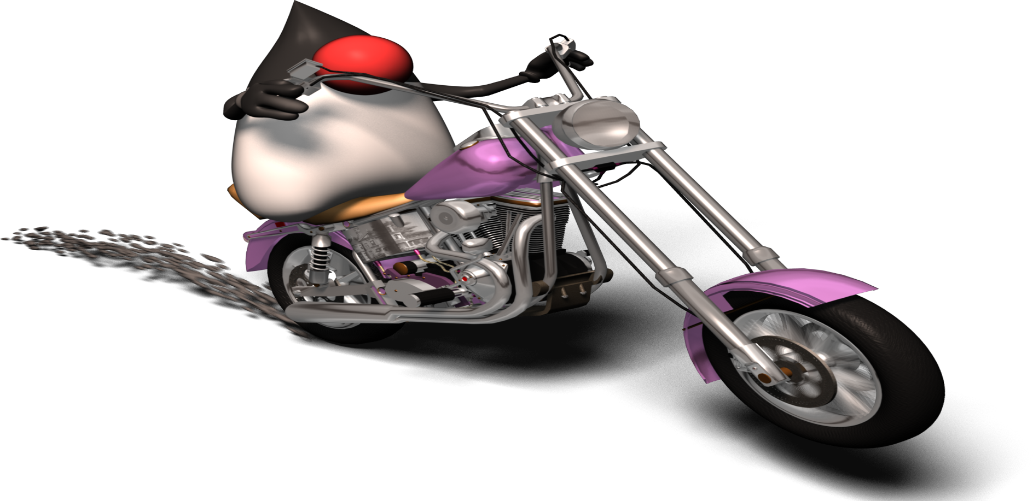
Comparison of various web service frameworks - WS Landscape
Apache CXF vs. Axis 2 vs. JAX-WS (RI)
Srinivas
00/00/2011

Slide 2
About Me
Working in Wells Fargo Bank as a java developer
Working in java past 13 years. I am a
  Sun Certified Enterprise Architect (I, II and III)
  Sun Certified Web Services Developer
  Sun Certified Business Component (EJB) Developer
  Sun Certified java Developer (I and II)
  Sun Certified java programmer and Web component developer
  Bea Certified Weblogic 7.0 Developer
Actively participates in Javaranch webServices and architect forums

Slide 3

Agenda
Various open source web service frame works
Introduction - Apache CXF
  CXF with JAX-WS
  CXF with JAX-RS (RESTfull Web services)
  Integrating CXF with Spring
Apache - Axis 2 (0.9 to 1.5.2)
  Axis 1 (JAX-RPC based)
  Axis 2 (JAX-WS based)
Comparison - Apache CXF vs. Axis2 vs. JAX-WS (RI)
Code Examples – for above all

Slide 4





Open Source Web Services Frameworks
Apache CXF =
Xfire + Celtix
Axis 1 & 2
JAX-WS (RI)
Spring WS

Slide 5
JAX-WS (RI) - JSR 224

Slide 6
JAX-WS (RI) – JSR 224
Successor of the JAX-RPC (JSR 101) specification
Annotation based programming model
Ease of development and high performance
Requires Java 1.5 and higher
Isn't downwardly compatible to its predecessor
JAX-RPC
Netbeans support

Slide 7


Apache – CXF (C + XF)
Celtix
XFire

Slide 8
Apache CXF
Services framework
It is the combination of two projects
  Celtix – IONA Technologies
  XFire – Codehaus
Combined by people and working together at Apache Software Foundation.

Slide 9









Apache CXF – Improvements over XFire
SOAP 1.1, 1.2
JAX-WS support
BP Complaint
JAX-RS
(JSR-311)
Spring 2/3 support
WS-* Complaint
WSDL Complaint
JSON and XML
support

Slide 10
Apache CXF – Improvements over XFire
Support for annotations
Support for data binding frameworks
Its possible to build both a SOAP and RESTfull
  endpoint with the same data objects and
  business logic.
Allows you to cater to different languages and
different integration styles easily.
Cleaner architecture and much more …

Slide 11
Annotations support
Server
  @WebService, @WebMethod, @WebParam, @WebResult
  Provider
  wsdl2java generated services
Cleint
  Dispatch
  wsdl2java generated services

Slide 12
REST and JAXB Annotations
Server
  @GET, @Path, @Produces etc.
XML Binding Annotations – Maps java classes to XML
  Package Level
  Class Level
  enum Type
  Properties and fields etc..
Example(s):
  @XmlRootElement ,@XmlElement, @XmlAttribute, @XmlElementWrapper etc..
  http://docs.sun.com/app/docs/doc/819-3669/6n5sg7bjt?a=view

Slide 13

Apache CXF – Configurations (JAX-WS)
<servlet>
<servlet-name>CXFServlet</servlet-name>
<servlet-class>
  org.apache.cxf.transport.servlet.CXFServlet
  </servlet-class>
</servlet>
<servlet-mapping>
<servlet-name>CXFServlet</servlet-name>
<url-pattern>/services/*</url-pattern>
</servlet-mapping>
web.xml

Slide 14

Spring with CXF – Configurations – JAX-WS
Example: java2wsdl:
<jaxws:endpoint
  id="auth" implementor="com.learning.cxf.AuthServiceImpl“
address="/cxfAuth"/>
Example: wsdl2java:
<jaxws:endpoint id="CXFLibraryService"
implementor="com.learning.cxf.CXFLibraryImpl"
wsdlLocation="WEB-INF/wsdl/library_test.wsdl"
address="/cxfLibraryService"/>
app-context.xml

Slide 15

Spring with CXF - Configurations (JAX-RS)
<jaxrs:server id="myservice" address="/">
  <jaxrs:serviceBeans>
  <ref bean="userServiceImpl"/>
  </jaxrs:serviceBeans>
  <jaxrs:extensionMappings>
  <entry key="xml" value="application/xml"/>
  </jaxrs:extensionMappings>
</jaxrs:server>
<bean id="userServiceImpl"
class="com.learning.cxf.UserServiceImpl"/>
app-context.xml

Slide 16
Axis-1 (Old Axis – JAX-RPC based)

Slide 17
Axis – Configurations (OLD Axis 1)
<servlet>
<servlet-name>AxisServlet</servlet-name>
<servlet-class>
org.apache.axis.transport.http.AxisServlet
</servlet-class>
</servlet>
<servlet-mapping>
<servlet-name>AxisServlet</servlet-name>
<url-pattern>/services/*</url-pattern>
</servlet-mapping>
web.xml

Slide 18
Axis – Configurations - .wsdd file
<!-- Service used for accessing -->
<service name="studentService" provider="java:RPC">
<requestFlow>
<handler type="soapmonitor"/>
</requestFlow>
<responseFlow>
<handler type="soapmonitor"/>
</responseFlow>
<parameter name="allowedMethods" value="*"/>
<parameter name="className" value="com.learning.ws.StudentServiceImpl"/>
</service>

Slide 19
Axis 2 – 0.93 to 1.5.2
(JAX-WS based)

Slide 20

Axis2 – Introduction - Improvements
Releases – 0.9 to 1.5.2
AXIOM, an XML object model optimized for SOAP 1.1/1.2 messages
Annotations support
REST support
JAX-WS support
C/C++ based web services
Support IIS 5.1, 6 and 7
Module architecture

Slide 21
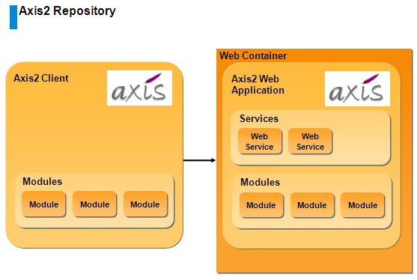
Axis 2 - Architecture

Slide 22
Axis2 (1.4, 1.5) – Steps (NEW)
Deploy the axis2.war file in any servlet container
Create a web service archive (.aar) file
Copy the archive file into
  webapps\axis2\WEB-INF\services directory
Restart the server

Slide 23

Axis2 (1.4, 1.5) – Steps
Axis 2 – .aar – package structure
Create a .aar file, deploy .aar in tomcat.

Slide 24

CXF vs. Axis2

Slide 25
CXF vs. Axis2
 | CXF | Axis2
Background/Frame work evaluation | Celtix + XFire | Came from Axis 1.x series
Ease of use | Quite Simple and Easy | Simple and Easy
Spring Integration | written with Spring in mind, clean integration with Spring | Axis is not, but supports
Community and support | Active | Active
JAX-WS support | Is priority | Is not number one priority, but supports
JAX-RS support | Supports standard JAX-RS API (JSR-311) | Can create RESTfull services, but less API support

Slide 26
CXF vs. Axis2
 | CXF | Axis2
Framework maturity | Mature | Quite Mature
Compatibility/Migration | Not so good | Same level (effort required )
Interoperability | Good | Good
Support for multiple languages | Support for Java, JSON | C/C++ version also available in addition to Java.
Corporate backup | IONA | WSO2
Life | CXF is catching up quickly, very popular these days | Longer
Development Style | Both (Java to WSDL and WSDL to Java) | Both

Slide 27
CXF vs. Axis2
 | CXF | Axis2
Performance | Same Level | Same Level
JDK versions support | Good for > 1.5 | Suitable for all versions
Data binding support | Very Good | Very Good, wide range of API’s.
Annotations support | Superior | Less compared to CXF
Admin Console for web services deployment and monitoring | N/A | Available in latest releases, (.aar file deployments)
Integrating with ESB(s) – Mule etc | Supports | Supports
Embedding the code into existing application | Very easy | Requires some effort (.aar deployment)

Slide 28
Spring (2,3) with REST

Slide 29
Spring 2 - with REST
Spring 2: Rest example : Using filters
<bean class="com.learning.rest.ParameterizedUrlHandlerMapping">
<property name="alwaysUseFullPath" value="true"/>
<property name="mappings">
<props>
<prop key="/contents/grades/*">allGrades</prop>
<prop key="/contents/lessons/*">allLessons</prop>
</props>
</property>
</bean>
<bean name="allGrades" class="com.learning.javaee.GradeController"/>
<bean name="allLessons" class="com.learning.javaee.LessonsDemoController"/>

Slide 30
Spring 3 - RestTemplate
Examples :
RestTemplate restTemplate = new RestTemplate();
String result = restTemplate.getForObject("http://localhost:8080/spdemo/services/myservice/user/{id}", String.class, "1");
System.out.println("result: " + result);
Map<String, String> vars = new HashMap<String, String>();
vars.put("grade", "1");
vars.put("subject", "Java");
String result1 = restTemplate.getForObject("http://localhost:8080/spdemo/services/myservice/grades/{grade}/subjects/{subject}",
String.class, vars);
http://blog.springsource.com/2009/03/27/rest-in-spring-3-resttemplate/

Slide 31

Summary – CXF vs. Axis2
Apache CXF
  JAX-WS
  JAX-RS (JSR-311)
AXIS
  Axis 1 (JAX-RPC)
  Axis 2 (JAX-WS and REST)
Spring
  Spring WS
  Spring with REST (2 and 3)
JAX-WS (RI)

Slide 32





Code Examples
CXF – JAX-WS
CXF – JAX-RS
Axis1 (old)
Axis2 (1.4,1.5.2)
Clients to invoke above all services

Slide 33

Which one to choose ??
Apache CXF vs. Axis 2 vs. JAX-WS vs. Spring WS

Slide 34
Which one to choose/use ??
Application has both REST and SOAP based services - CXF
Tight integration with Spring - CXF
Want to expose existing spring beans to SOAP messages - CXF
Embedding web services inside your existing code - CXF
More emphasize on Code first design - CXF
Slim and easy to use, sufficient JAX-WS support – CXF
Support for multiple languages – Axis2
Administration using simple UI – Axis2

Slide 35
Which one to choose/use ??
Axis2 offers modules providing additional functionality – Axis2
Support of exchangeable binding frameworks–Axis2
To deploy code as many independent services (multiple .aar files) – Axis2
Code against standard and more IDE support in Net Beans – JAX-WS (RI)
Non-Technical
  Pushing very hard and less time for development

Slide 36
References
http://blogs.sun.com/jag/entry/so_long_old_friend
http://docs.sun.com/app/docs/doc/819-3669/6n5sg7bjt?a=view
http://www.theserverside.com/tt/articles/article.tss?l=AxisAxis2andCXF
http://www.predic8.com/axis2-cxf-jax-ws-comparison.htm
http://static.springsource.org/spring-ws/sites/1.5/reference/html/
http://ws.apache.org/axis2/1_1_1/adv-userguide.html
http://ws.apache.org/axis2/0_95/webadminguide.html#login
http://cxf.apache.org/
http://cxf.apache.org/resources-and-articles.html
http://soasidewalk.blogspot.com/2007/09/apache-cxf-alternative-to-axis.html
http://blog.springsource.com/2009/03/27/rest-in-spring-3-resttemplate/
http://agileskills2.org/DWSAA/Chapters1-2.pdf
http://svn.apache.org/viewvc/cxf/trunk/distribution/src/main/release/samples/

Slide 37
Resources
http://www.theserverside.com/news/1363958/Axis-Axis2-and-CXF-Surveying-the-WS-Landscape
http://www.predic8.com/axis2-cxf-jax-ws-comparison.htm
http://www.ibm.com/developerworks/java/library/j-jws14/index.html – Performance
http://axis.apache.org/axis2/java/core/docs/quickstartguide.html - AXI2 POJO example

Slide 38
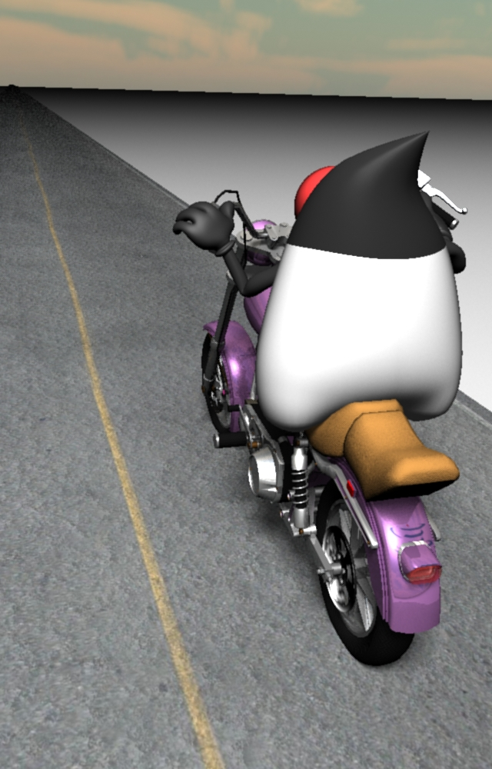
Thank You

